Slide 1
Monday February 1, 2016
Do Now:
Standards:ELAGSE9-10W4: Produce clear and coherent writing in which the development, organization, and style are appropriate to task, purpose, and audience.
ELAGSE9-10RL2: Determine a theme and/or central idea of text and closely analyze its development over the course of the text, including how it emerges and is shaped and refined by specific details; provide an objective summary of the text
Agenda:
Reading Check Chapters 12-15
Chapter 12-15 Study Questions discussion
Begin in-class reading of Chapter 16-Due tomorrow
SAT Vocabulary Quiz next Wednesday: Study definitions and spelling

Slide 2
Study Questions Chapter 12
1. Why do Jem and Scout go to church with Calpurnia? Where is Atticus?
2. Why is the church named First Purchase?
3. Does Lula speak for the majority opinion in the congregation? Why does the author include her in the church scene?
4. What is the crime that’s been charged against Tom Robinson?
5. Why can’t Helen Robinson work and support her three children?
6. During the church service, we find out that Calpurnia is one of the few African-American residents of Maycomb who can read. The children get to know Cal better during this Sunday and realize lots of things about her that they didn’t know, including that she’s older than they realized. Look closely at this passage: “But, Cal,” Jem protested, “you don’t look even near as old as Atticus.” “Colored folks don’t show their ages so fast,” she said. “Maybe because they can’t read...” What’s humorous or interesting about this short passage?
7. What nasty surprise awaits the children at the very end of the chapter?

Slide 3
Study Questions Chapter 13
1. Scout and Aunt Alexandra communicate very poorly with each other. Is the fault more with one than the other, or are they equally at fault? Explain your answer.
2. What’s the reason the children are given as to why Aunt Alexandra has come to stay with them? What do you think is the real reason?
3. Atticus says to Scout, “Your aunt’s doing me a favor as well as you all. I can’t stay here all day with you, and the summer’s going to be a hot one.” There’s a double-meaning to this line. Explain.
4. Aunt Alexandra is critical of many of Maycomb’s families. According to Jem, what’s ironic about this?
5. What did Cousin Joshua do and how does he become a wedge between Aunt Alexandra and Atticus?
6. Look at the last short paragraph of the chapter. What was Atticus trying to do? Why is this sort of thing, according to Scout, better left to a woman?

Slide 4
Study Questions Chapter 14
1. How does Aunt Alexandra feel about Calpurnia? Explain why this is “in character” for Aunt Alexandra?
2. Comment on Atticus’ explanation of rape. Why does Atticus explain the crime in this way?
3. What does Jem do that, to Scout, symbolizes the end of his childhood?
4. Dill tries to explain to Scout why he did not want to stay with his mother and new stepfather. State his reasons briefly in your own words.
5. Twice now, Scout has considered running away. Dill did, in fact, run away from home. Why, according to Dill, hasn’t Boo Radley ever run away from his terrible home?

Slide 5
Study Questions Chapter 15
1. What was the “sickening comic aspect” of Atticus’ exchange with the small mob of men? What does this show us about the men in the small mob? About Atticus?
2. Why does Jem openly defy Atticus and refuse to leave?
3. What does Scout’s childish attempt at conversation accomplish? Explain.
4. Why was Atticus so affectionate toward Jem, even after Jem disobeyed him?

Slide 6
Tuesday February 2, 2016
Do Now: Write a sentence using two of the SAT vocabulary words.
Standards:ELAGSE9-10W4: Produce clear and coherent writing in which the development, organization, and style are appropriate to task, purpose, and audience.
ELAGSE9-10RL2: Determine a theme and/or central idea of text and closely analyze its development over the course of the text, including how it emerges and is shaped and refined by specific details; provide an objective summary of the text
Agenda:
Chapter 16 Study Questions Discussion
In class reading of Chapter 17
Finish and complete Chapter 18 by tomorrow
SAT Vocabulary Quiz TOMORROW: Study definitions and spelling

Slide 7
Chapter 16 Study Questions
1. What does Scout learn about mob mentality?
2. Mr. Dolphus Raymond is evidently a complicated and interesting person. Describe his way of life and comment on its effect upon the town.
3. Why did Mr. Dolphus Raymond’s fiance die? What does this show the reader about life in Maycomb?
4. Jem says that “mixed” children are sad because they don’t belong anywhere. What does he mean? Is having a sense of belonging important in life? Explain your thoughts.
5. Judge Taylor’s appearance and his ability are two different things. What comment might the author be making in building the judge in this way?
6. Symbolically, what does the physical structure of the courthouse show us about the people of Maycomb?
7. Why didn’t Atticus tell his children that he had to defend Tom Robinson, that he was appointed by the court and didn’t really have a choice about taking the case?
8. Why do the four men give up their seats for Jem, Scout, Dill, and Reverend Sykes? What does this show us?
9. As the examination begins, Atticus’ table is bare. What does this show us?

Slide 8
Chapter 18 Study Questions
1. What does Atticus do that makes Mayella Ewell think that he’s making fun of her? What does this show us about Mayella’s life?
2. What is so important about Tom Robinson’s physical appearance? What, according to the testimony, does this prove beyond a doubt?
3. Is Mayella like her father or different from him? In what ways?
4. What does Scout notice about Mayella as she leaves the witness stand and passes Atticus’ defense table?

Slide 9
Wednesday February 3, 2016
Do Now:
Study for your vocabulary quiz
Standards:ELAGSE9-10W4: Produce clear and coherent writing in which the development, organization, and style are appropriate to task, purpose, and audience.
ELAGSE9-10RL2: Determine a theme and/or central idea of text and closely analyze its development over the course of the text, including how it emerges and is shaped and refined by specific details; provide an objective summary of the text
Agenda:
Chapter 17-18 Reading Check
SAT Vocabulary Quiz
Once finished, read Chapter 19 (Due tomorrow)

Slide 10
Thursday February 4, 2016
Do Now:
Mrs. Bass out
Standards:ELAGSE9-10W4: Produce clear and coherent writing in which the development, organization, and style are appropriate to task, purpose, and audience.
ELAGSE9-10RL2: Determine a theme and/or central idea of text and closely analyze its development over the course of the text, including how it emerges and is shaped and refined by specific details; provide an objective summary of the text
Agenda:
Chapter 20 Reading and Study Questions

Slide 11
Friday February 5, 2016
Do Now: 100 Word Count
How do you feel about sheltering children from unpleasant truths (death, disease, crimes such as rape, murder)?
When is it important for children to know such truths?
When is it better to keep them in the dark? Is it right for an adult to lie to a child to shield him or her?
Standards:ELAGSE9-10W4: Produce clear and coherent writing in which the development, organization, and style are appropriate to task, purpose, and audience.
ELAGSE9-10RL2: Determine a theme and/or central idea of text and closely analyze its development over the course of the text, including how it emerges and is shaped and refined by specific details; provide an objective summary of the text
Agenda:
Chapter 19 and 20 Reading Check
-Courtroom Reporter Activity
Due at end of period
HW: Read Chapters 21-23 over the weekend

Slide 12
Chapter 17 Study Questions
1. Scout says that Atticus has an “infinite capacity for calming turbulent seas.” What does she mean by this? Is this true?
2. In history, who was Robert E. Lee? Feel free to look up this info. and write down what you discover. What’s interesting about this man being Mr. Ewell’s namesake?
3. Looking at the Ewell property, what item stands out as not belonging with all of the other broken junk? What might this symbolize?
4. Reverend Sykes has second thoughts about allowing the children to stay and listen to the graphic testimony, but ultimately relents to Jem and allows them to stay. Why doesn’t Rev. Sykes force them to leave?
5. Judge Taylor refuses to close the courtroom and says, “People generally see what they look for, and hear what they listen for, and they have the right to subject their children to it...” What does he mean?
6. Why didn’t Mr. Ewell have a doctor check out his daughter? What does this show us about the man?
7. What’s compelling about the fact that Mr. Ewell is left-handed?
8. Look at the last line of the chapter. What is the old saying that Scout refers to here? How is this an appropriate idiom for this point in the trial?

Slide 13
Chapter 18 Study Quesitons
1. What does Atticus do that makes Mayella Ewell think that he’s making fun of her? What does this show us about Mayella’s life?
2. What is so important about Tom Robinson’s physical appearance? What, according to the testimony, does this prove beyond a doubt?
3. Is Mayella like her father or different from him? In what ways?
4. What does Scout notice about Mayella as she leaves the witness stand and passes Atticus’ defense table?

Slide 14
Chapter 19 Study Questions
1. Why does Atticus mention Tom’s previous record of conviction?
2. Explain Tom’s version of the events on the evening of Nov. 21.
3. In that moment with Mayella, Tom is in a no-win situation. Explain the “subtlety of Tom’s
predictament.”
4. How is Mr. Link Deas heroic?
5. Why was it a “mistake” for Tom to say that he felt sorry for Mayella?
6. Miss Maudie once said that Atticus Finch is “the same in the courtroom as he is on the public streets.” What makes this such an awesome compliment?
7. Dill becomes physically sensitive at the end of the chapter, so he and Scout leave to get some fresh air. Is Dill too sensitive? What’s the author’s message in having Dill become ill?

Slide 15
Chapter 20 Reading Questions
1. At the beginning of the chapter, we find out that Mr. Raymond sips only Coca-Cola from a paper sack, deliberately pretending to be drunk. Why does he do this?
2. Why does Mr. Raymond tell Scout and Dill about his life?
3. Scout says that Mr. Dolphus Raymond was “an evil man.” Is she right? Explain your answer.
4. Why, according to Atticus, did Mayelle throw her false accusation at Tom?
5. According to Atticus, what is the only institution that can serve as an equalizer of men? Do you agree with this idea?

Slide 16
Monday February 8, 2016
Do Now:
Standards:ELAGSE9-10W4: Produce clear and coherent writing in which the development, organization, and style are appropriate to task, purpose, and audience.
ELAGSE9-10RL2: Determine a theme and/or central idea of text and closely analyze its development over the course of the text, including how it emerges and is shaped and refined by specific details; provide an objective summary of the text
Agenda:
Chapter 21-23 Reading Check
Chapters 17-20 Study Questions
Chapter 24-26 Reading for Homework: Due Wednesday
To Kill a Mockingbird Exam next Friday. 2/19

Slide 17
Tuesday February 9, 2016
Do Now: Journal Prompt
Consider and write why people fail to do the right thing, even though their consciences clearly tell them what to do.
Which influences would you be likely to personally resist, and which might overrule your conscience?
Standards:ELAGSE9-10W4: Produce clear and coherent writing in which the development, organization, and style are appropriate to task, purpose, and audience.
ELAGSE9-10RL2: Determine a theme and/or central idea of text and closely analyze its development over the course of the text, including how it emerges and is shaped and refined by specific details; provide an objective summary of the text
Agenda:
Chapters 21-23 Study Question Discussion
Essay topic introduction
Edmodo Poll
Chapter 24-26 Reading for Homework due TOMORROW
To Kill a Mockingbird Exam NEXT Friday. February 19th

Slide 18
Chapter 21 Study Questions
1. Jem is confident that Atticus has won the case, but Atticus is not as certain. Write the line of text that shows Atticus knows he’ll lose, but that he’s not ready to take away Jem’s hope.
2. Why is a long-deliberating jury a good sign?
3. How does Scout “know” the verdict before she hears it?
4. Why do the people in the balcony gallery stand when Atticus leaves the courtroom?

Slide 19
Chapter 22 Study Questions
1. Aunt Alexandra tries to scold Atticus for allowing the children to attend the trial, but Atticus says, “This is their home, sister...We’ve made it this way for them, they might as well learn to cope with it.” Explain Atticus’ message.
2. Atticus lost the case, yet the black community has reacted with generosity, filling his kitchen with food. Why did people drop off so much food?
3. What’s interesting about Miss Maudie’s cake?
4. How did Judge Taylor try to help Tom?
5. What “baby step” was made with this case?
6. What does Dill say he wants to be when he’s grown? Why?
7. At the end of the chapter, what do we discover happened to Atticus that morning?

Slide 20
Chapter 23 Study Questions
1. How does Atticus react to Bob Ewell’s threat against him?
2. What is “circumstantial evidence” and what does it have to do with Tom’s case?
3. In thinking about the injustices faced by Tom and other members of the African-American community, Atticus says, “Don’t fool youselves – it’s all adding up and one of these days we’re going to pay the bill for it. I hope it’s not in you children’s time.” What is his concern/prediction about the future?
4. Aunt Alexandra accepts that the Cunninghams may be good people, but she still thinks “they’re not our kind of folks.” Later, she calls them “trash.” This book was first published in 1960 and set in the 1930s, yet these class distinctions are still with us today. Why do you think, as Scout says so clearly toward the end of the chapter, folks just don’t get along with each other? Why do we allow this separation of race and class to still exist?
5. At the end of this chapter, Jem forms a new theory about why Boo Radley rarely leaves his house. What is this? How likely is it to be true?

Slide 21
To Kill a Mockingbird Essay Topics
Choose ONE of the five sentences below and consider whether you agree or disagree with the idea. Build a persuasive essay in which you examine the idea in the statement and either prove or disprove it using an example from To Kill a Mockingbird and a separate example from our modern world (1980 to today). This persuasive essay will require you to dig into Harper Lee’s novel to provide textual support for your stance, as well as evidence of research on the modern example that you include in your argument. Be sure to keep track of your source citation material, as M.L.A. in-text citation and a Works Cited page are required. Topic Options:
1. America will never achieve true racial and social equality.
2. Friends are a more powerful influence on children than parents.
3. The quietest people are often the most powerful.
4. A lady knows that one can trap more flies with sugar than vinegar.
5. It is impossible to become a strong, productive adult if one had an abusive or neglected childhood.

Slide 22
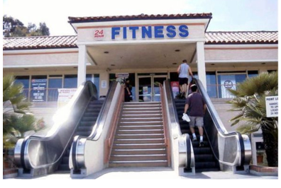
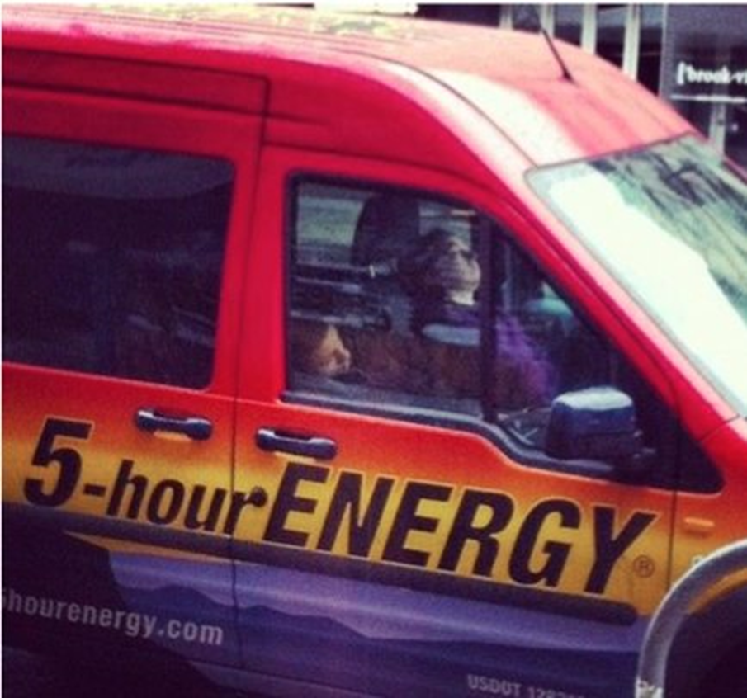
Wednesday February 10, 2016
Do Now: What is irony?
Agenda:
2nd Period Silent Class
Chapter 24-26 Reading check
Study Questions discussion
Chapter 27-31 due Friday
To Kill a Mockingbird Exam NEXT Friday February 19th
Standards:ELAGSE9-10W4: Produce clear and coherent writing in which the development, organization, and style are appropriate to task, purpose, and audience.
ELAGSE9-10RL2: Determine a theme and/or central idea of text and closely analyze its development over the course of the text, including how it emerges and is shaped and refined by specific details; provide an objective summary of the text

Slide 23
Chapter 24 Study Questions
1. Do you think the missionary ladies are sincere in worrying about the “Mrunas,” a tribe in Africa? Give reasons for your answer. Be sure to include any ironic elements you notice in this part of the chapter.
2. Scout feels she prefers men to women. Why? Do you agree with her reasons?
3. Compare the reactions of Miss Maudie and the other ladies when Scout says she is wearing her “britches” under her dress.
4. Explain briefly how Tom was killed. What is Atticus’ explanation for Tom’s attempted escape? Do you agree with Atticus?
5. Miss Maudie says, “We’re paying the highest tribute we can pay a man.” What does she mean?
6. Toward the end of this chapter, we see Aunt Alexandra in a new light. How so? Explain how Miss Maudie becomes a sudden supporter of Alexandra.

Slide 24
Chapter 25 Study Questions
1. Explain how Scout’s treatment of the roly-poly bug mirrors the way the town of Maycomb
treated Tom Robinson.
2. Everyone in town talks about Tom’s death, most saying it’s “typical.” What do they mean?
3. Write the line from the end of the chapter in which Mr. Underwood’s editorial in the Maycomb Tribune echoes Atticus’ earlier advice to Jem and Scout when they were given their guns. Then, explain how this connects to the title of the novel. Who is the mockingbird?
4. At the end of the book, the children find out that Mr. Ewell was thrilled to hear about the death of Tom and reportedly “said it made one down and about two more to go.” Who, do you suppose, are the “two more” that Mr. Ewell is targeting? Do you believe his threat?

Slide 25
Chapter 26 Study Questions
1. Apparently, Atticus has known all along about the night Jem lost his pants on the Radleys’ fence, but he never felt the need to say anything about it. What physical evidence led Atticus to make his realization?
2. Despite the drama of the summer, Atticus wins an unopposed re-election to the state legislature in the fall. Give two possible meanings that could be taken from this.
3. In her lesson on Hitler, Miss Gates says that Americans “don’t believe in persecuting anybody.” What’s ironic about her statement?
4. Why does Scout’s question upset Jem?

Slide 26
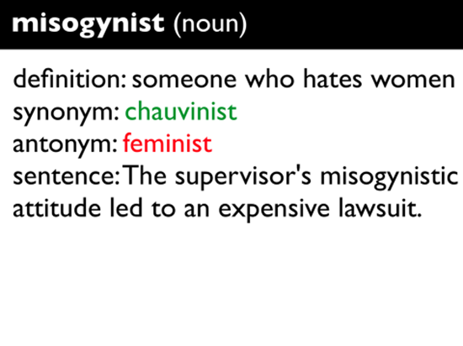
Thursday February 11, 2016
Agenda:
Courtroom Scene Assignments and Grouping
Chapter 27-31 Reading due Tomorrow- It is going to be extremely difficult
Courtroom Scenes begin Tuesday
To Kill a Mockingbird Exam NEXT Friday. February 19th
Do Now:
Standards:ELAGSE9-10W4: Produce clear and coherent writing in which the development, organization, and style are appropriate to task, purpose, and audience.
ELAGSE9-10RL2: Determine a theme and/or central idea of text and closely analyze its development over the course of the text, including how it emerges and is shaped and refined by specific details; provide an objective summary of the text

Slide 27
Friday February 12, 2016
Do Now:
List some important realizations that a child must make before becoming an adult. (Example: Life isn’t fair.)
Which of these facts of life are most difficult to accept? Which are the most important to accept? Why?
Standards:ELAGSE9-10W4: Produce clear and coherent writing in which the development, organization, and style are appropriate to task, purpose, and audience.
ELAGSE9-10RL2: Determine a theme and/or central idea of text and closely analyze its development over the course of the text, including how it emerges and is shaped and refined by specific details; provide an objective summary of the text
Agenda:
Chapter 27-31 Reading Quiz
Study Question Discussions
Crash Course
Courtroom Prep.
Courtroom scenes Tuesday!
To Kill a Mockingbird Exam NEXT Friday February 19th

Slide 28
Chapter 27-31 Reading Check
27. After Mr. Link Deas yells at Bob Ewell, what does Ewell do to intimidate Helen Robinson?
28. At the end of this chapter, where is Bob Ewell’s body?
29. Why didn’t Atticus or Aunt Alexandra hear the children yelling?
30. Why does Atticus invite Heck Tate and Arthur “Boo” Radley to chat on the porch instead of in the living room?
31. Boo Radley speaks just five words in this entire novel when he asks Scout a question. What does Boo ask Scout?

Slide 29
Chapter 27 Study Questions
1. What were the three notable things that happened in Maycomb by the middle of October? How does the circumstance of each show the reader something about Bob Ewell’s character?
2. What part of the Mruna family structure do the Maycomb ladies find particularly offensive? What do you think of this system?
3. Why do Atticus and Aunt Alexandra not intend to go to the Halloween pageant?
4. The last line of the chapter gives a sense of foreboding to the reader because, clearly, something dark and nefarious is going to happen this evening. Look back over the chapter and write down another line of text or paraphrase a plot element that contributes to this foreshadowing of something bad to come.

Slide 30
Chapter 28 Study Questions
1. There are several misfortunate elements to the evening that leave Jem and Scout especially vulnerable to Mr. Ewell’s attack. Name four of these elements.
2. Scout’s view of the events in the field are obscurred by her ham costume. Using her descriptions and information from the end of the chapter, retell the events of the attack as you understand them.
3. What’s significant about the clothing that Aunt Alexandra hands to Scout when she arrives home?
4. We don’t know yet who the stranger is that carried Jem home, but you might have a good idea. Take a guess.

Slide 31
Chapter 29 Study Questions
1. What does Atticus think was wrong with Mr. Ewell? What does Heck Tate think was wrong with Mr. Ewell? With whom do you agree and why?
2. What causes the “shiny clean line” on the otherwise “dull wire” of Scout’s costume?
3. Briefly describe the meeting between Scout and Boo.

Slide 32
Chapter 30 Study questions
1. When Atticus first thinks that Jem was the one who killed Bob Ewell, what is Atticus ready to do? What does this show the reader about Atticus?
2. Atticus and Heck Tate have a heated argument, as Atticus assumes Heck is ready to cover up Bob Ewell’s killing as a move to protect Jem. Who is Heck really trying to protect? Why does Heck fight so hard to protect this person?
3. Heck Tate has tampered with evidence to make it appear that Ewell was killed by falling on his own knife. What piece of evidence did Heck remove from the scene of the crime?
4. Did Heck Tate do the right thing? Explain your answer.
5. Scout, who was confused about the actual cause of Mr. Ewell’s death, agrees with Heck Tate’s decision and utters an elegant line in support of him. Write that line.

Slide 33
Chapter 31 Study Questions
1. After she takes Boo home, Scout understands many new things because she is able to see the street from his point of view. Explain some of the things she now understands about Boo’s perspective.
2. In what way is Scout’s neighborhood/street similar to the Mruna tribe in Africa?
3. Reread the first line from chapter 1. How do the events in the final chapters connect to this line? Do you find this storytelling technique effective? Why or why not?
4. At the end of the novel, Atticus reads to Scout as she drifts off to sleep. How does the topic of the story connect to one of this novel’s major themes?

Slide 34
Chapter 27-31 Reading Check
27. Describe the trick that Maycomb’s kids played on Miss Tutti and Miss Frutti.
28. As Jem and Scout are walking to the high school early in the evening, who jumps out and scares them?
29. It was dark and Scout couldn’t see because of her cumbersome costume. How did she know that the attack happened under the big tree?
30. How many knives did Heck Tate really find at the crime scene?
31. Boo Radley speaks just five words in this entire novel when he asks Scout a question. What does Boo ask Scout?

Slide 35
Chapter 27-31 Reading Check
27. Why couldn’t Helen Robinson walk on the public road to her job?
28. What did Scout do that “ruined” Mrs. Merriweather’s pageant?
29. Other than Jem’s broken arm, what other physical evidence exists that shows Bob Ewell was determined to hurt, and likely kill, the children?
30. How many knives did Heck Tate really find at the crime scene?
31. What does Scout encourage Boo to do that Jem would never allow if he were awake?

Slide 36
Tuesday February 16, 2016
Do Now:
Sit with your group and get ready to present.
Standards:ELAGSE9-10W4: Produce clear and coherent writing in which the development, organization, and style are appropriate to task, purpose, and audience.
ELAGSE9-10RL2: Determine a theme and/or central idea of text and closely analyze its development over the course of the text, including how it emerges and is shaped and refined by specific details; provide an objective summary of the text
Agenda:
Courtroom Scene Presentations
To Kill a Mockingbird Exam Friday. February 19th
Bring your vocabulary sheet to help on the test.
Study quotes, characters, and events from the story.

Slide 37
Wednesday February 17, 2016
Do Now:
Find a quote from TKAM that represents one of the major themes of the novel.
Standards:ELAGSE9-10W4: Produce clear and coherent writing in which the development, organization, and style are appropriate to task, purpose, and audience.
ELAGSE9-10RL2: Determine a theme and/or central idea of text and closely analyze its development over the course of the text, including how it emerges and is shaped and refined by specific details; provide an objective summary of the text
Agenda:
Finish Courtroom Scenes
Timeline Review Activity
To Kill a Mockingbird Exam Friday. February 19th

Slide 38
Thursday February 18, 2016
Do Now:
Download the app “Aurasma” on your phone
(Don’t worry it’s free)
Click on Triangle to take to Home Page
Search “Bass.Ashley.E”
Click on account
Click “Follow All”
Standards:ELAGSE9-10W4: Produce clear and coherent writing in which the development, organization, and style are appropriate to task, purpose, and audience.
ELAGSE9-10RL2: Determine a theme and/or central idea of text and closely analyze its development over the course of the text, including how it emerges and is shaped and refined by specific details; provide an objective summary of the text
Agenda:
Exam review Aurasma
Kahoot Review game
To Kill a Mockingbird Exam Tomorrow February 19th

Slide 39
Character Aurasma Review
10. Judge Taylor
11. Calpurnia
12.Tom Robinson
13. Bob Ewell
14Mayella Ewell
15.Reverend Sykes
16. Arthur (Boo) Radley
Extra Videos:
17. Atticus shoots Tim Johnson
18. Atticus gives Advice
19. The Trial
20.Background to Novel
Atticus Finch
Jean Louise Finch (Scout)
Jeremy Atticus Finch (Jem)
Charles Baker Harris (Dill)
Miss. Maudie
Miss. Stephanie Crawford
Ms. Dubose
Miss. Caroline
Heck Tate

Slide 40
Friday February 19, 2016
Do Now:
Review your notes and prepare for the test.
Standards:ELAGSE9-10W4: Produce clear and coherent writing in which the development, organization, and style are appropriate to task, purpose, and audience.
ELAGSE9-10RL2: Determine a theme and/or central idea of text and closely analyze its development over the course of the text, including how it emerges and is shaped and refined by specific details; provide an objective summary of the text
Agenda:
To Kill a Mockingbird Exam

Slide 41
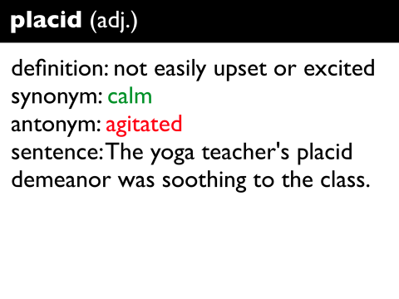
Monday February 22, 2016
Do Now:
Agenda:
Pick your Persuasive Essay Prompt
Begin To Kill a Mockingbird Film
Standards:ELAGSE9-10W4: Produce clear and coherent writing in which the development, organization, and style are appropriate to task, purpose, and audience.
ELAGSE9-10RL2: Determine a theme and/or central idea of text and closely analyze its development over the course of the text, including how it emerges and is shaped and refined by specific details; provide an objective summary of the text

Slide 42
To Kill a Mockingbird Essay Topics
Choose ONE of the five sentences below and consider whether you agree or disagree with the idea. Build a persuasive essay in which you examine the idea in the statement and either prove or disprove it using an example from To Kill a Mockingbird and a separate example from our modern world (1980 to today). This persuasive essay will require you to dig into Harper Lee’s novel to provide textual support for your stance, as well as evidence of research on the modern example that you include in your argument. Be sure to keep track of your source citation material, as M.L.A. in-text citation and a Works Cited page are required. Topic Options:
1. America will never achieve true racial and social equality.
2. Friends are a more powerful influence on children than parents.
3. The quietest people are often the most powerful.
4. A lady knows that one can trap more flies with sugar than vinegar.
5. It is impossible to become a strong, productive adult if one had an abusive or neglected childhood.

Slide 43
Tuesday February 23, 2016
Do Now:
Standards:ELAGSE9-10W4: Produce clear and coherent writing in which the development, organization, and style are appropriate to task, purpose, and audience.
ELAGSE9-10RL2: Determine a theme and/or central idea of text and closely analyze its development over the course of the text, including how it emerges and is shaped and refined by specific details; provide an objective summary of the text
Agenda:
Essay writing Brainstorming
1.Write down your prompt.
2. Do you agree or disagree?
3. Brainstorm reasons why you agree or disagree
Continue To Kill a Mockingbird Film

Slide 44
Wednesday February 24, 2016
Do Now:
Agenda:
Narrow your brainstorming ideas down to three main points.
Share your three reasons why you agree or disagree with your statement with a partner.
To Kill a Mockingbird Film
Standards:ELAGSE9-10W4: Produce clear and coherent writing in which the development, organization, and style are appropriate to task, purpose, and audience.
ELAGSE9-10RL2: Determine a theme and/or central idea of text and closely analyze its development over the course of the text, including how it emerges and is shaped and refined by specific details; provide an objective summary of the text

Slide 45
Thursday February 25, 2016
Do Now:
Standards:ELAGSE9-10W4: Produce clear and coherent writing in which the development, organization, and style are appropriate to task, purpose, and audience.
ELAGSE9-10RL2: Determine a theme and/or central idea of text and closely analyze its development over the course of the text, including how it emerges and is shaped and refined by specific details; provide an objective summary of the text
Agenda:
Creating an Outline for your essay
To Kill a Mockingbird Film
All late work must be turned in next week!

Slide 46
Friday February 26, 2016
Do Now:
How does the movie compare to the book? Did you imagine the characters to be similar or different? Explain.
Standards:ELAGSE9-10W4: Produce clear and coherent writing in which the development, organization, and style are appropriate to task, purpose, and audience.
ELAGSE9-10RL2: Determine a theme and/or central idea of text and closely analyze its development over the course of the text, including how it emerges and is shaped and refined by specific details; provide an objective summary of the text
Agenda:
TKaM Inspiration
To Kill a Mockingbird Film
All makeup work must be turned in next week!

